Slide 1

DDL (Data Definition Language)
Commands

Slide 2

Course Outline
DDL (Data Definitions Language) Commands
DML (Data Manipulation Language) Commands
Retrieve Data from Multiple Tables
Inbuilt Functions in SQL
Create Advance Database Objects

Slide 3


DDL (Data Definitions Language)
Commands

Slide 4

Objectives
After completing this module, you should be able to:
Perceive RDBMS (Relational Database Management System) Introduction
Use Normalization in RDBMS
Create database objects
Delete database objects
Alter database objects
Create, alter and delete constraints

Slide 5








Relation Database Management System (RDBMS)
In relational databases, the relationship between data files is relational. These databases connect to the data in different files by using common data numbers or a key field. Data in relational databases is stored in different access control tables, each having a key field that mainly identifies each row. In relational databases, tables or files filled up with data are called relations designates a row or record, and columns are referred to as attributes or fields.
It's Values are Atomic
In Each Row is alone
In the relational database we have to follow some properties
Column Values are of the same thing
Columns are undistinguished
Sequence of Rows is Insignificant Each Column has a common Name

Slide 6


Normalization
To minimize duplicate data
Normalization is the process of organizing data to avoid duplication and redundancy
To minimize or avoid data modification issues
To simplify queries

Slide 7
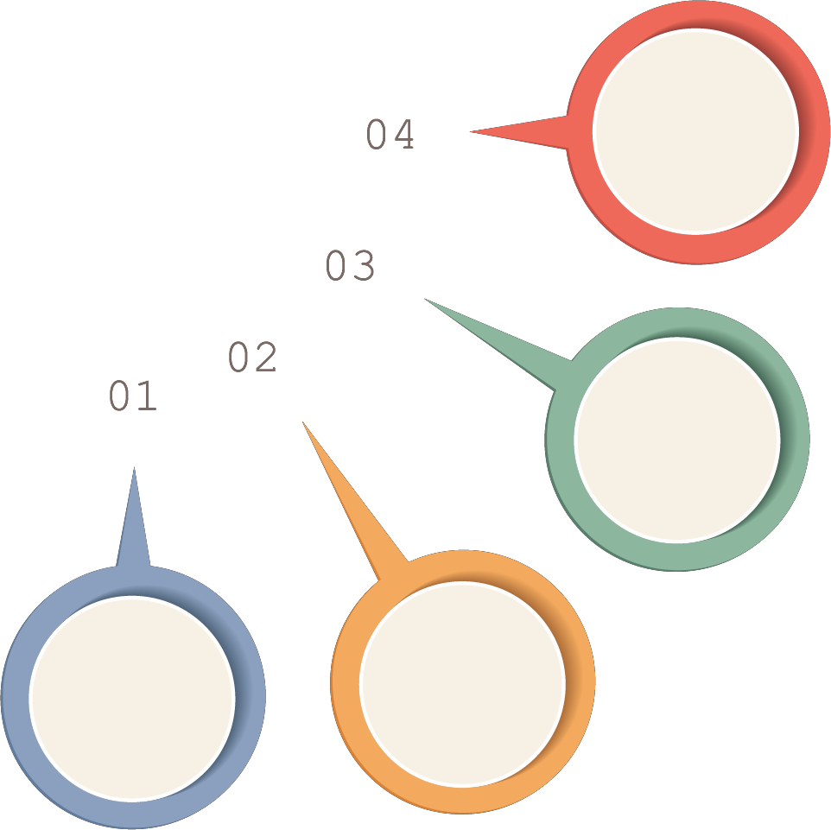
Normalization Types
Normalization rule are divided into following normal form
To minimize duplicate data
To minimize or avoid data modification issues
To simplify queries

Slide 8
First Normal Form
As per First Normal Form:
Each set of column must have a unique value, such that multiple columns cannot be used to fetch the same row
Each table should be organized into two, and each row should have a primary key that identifies it as unique
The Primary key is usually a single column, but sometimes more than one column can be combined to create a single primary
key
Student | Age | Course
Adam | 15 | CR001, CR005
Alex | 14 | CR005
Stuart | 17 | CR005
Student | Age | Course
Adam | 15 | CR001
Adam | 15 | CR005
Alex | 14 | CR005
Stuart | 17 | CR005
Using the First Normal Form, data redundancy increases, as there will be many columns with same data in multiple rows but
each row as a whole will be unique

Slide 9

Second Normal Form- 2NF
As per Second Normal Form:
There must not be any partial dependency of any column on primary key
A table that has concatenated primary key, each column in the table that is not part of the primary key must depend
upon the entire concatenated key for its existence
If any column depends only on one part of the concatenated key, then the table fails Second normal form
In example of First Normal Form there are two rows for Adam, to include multiple subjects that he has opted for
The candidate key is {Student, Course}, Age of Student only depends on Student column, which is incorrect as per Second Normal Form

Slide 10
Second Normal Form- 2NF (Cont’d…)
To achieve second normal form, it would be helpful to split out the subjects into an independent table, and match them up using the student names as foreign keys
New Student Table following 2NF will be:
New Subject Table introduced for 2NF will be:
Student | Age
Adam | 15
Adam | 15
Alex | 14
Stuart | 17
Student | Course
Adam | CR001
Adam | CR005
Alex | CR005
Stuart | CR005
In Subject Table the candidate key will be {Student, Course} column. Now, both the above tables qualifies
for Second Normal Form and will never suffer from Update Anomalies

Slide 11
Third Normal Form- 3NF
Third Normal form applies that every non-prime attribute of table must be dependent on primary key, or we can say that, there should not be the case that a non-prime attribute is determined by another non-prime attribute
So this transitive functional dependency should be removed from the table and also the table must be in Second Normal form
Student Detail Table:
Student_id | Student_name | DOB | Street | city | State | Zip
In this table Student_id is Primary key, but street, city and state depends upon Zip. The dependency between zip and other fields is called transitive dependency. Hence to apply 3NF, we need to move the street, city and state to new table, with Zip as primary key
New Student_Detail Table:
Address Table:
Student_id | Student_name | DOB | Zip
Zip | Street | city | State

Slide 12
Boyce and Codd Normal Form (BCNF)
Third Normal form applies that every non-prime attribute of table must be dependent on primary key, or we can say that, there
should not be the case that a non-prime attribute is determined by another non-prime attribute
So this transitive functional dependency should be removed from the table and also the table must be in Second Normal form
Student Detail Table:
Student_id | Student_name | DOB | Street | city | State | Zip
In this table Student_id is Primary key, but street, city and state depends upon Zip. The dependency between zip and other fields is called transitive dependency. Hence to apply 3NF, we need to move the street, city and state to new table, with Zip as primary key
New Student_Detail Table:
Address Table:
Student_id | Student_name | DOB | Zip
Zip | Street | city | State

Slide 13
Data Types in SQL
A data type is an attribute that specifies the type of data that the object can hold: integer data, character data, monetary data, date and time data, binary strings, and so on
Binary
Data and
Time
Character
String
Numeric

Slide 14
Character String Data Type
Data Type | Description | Length
char(n) | Stores n characters | n bytes (where n is in the range of 1–8,000)
nchar(n) | Stores n Unicode characters | 2n bytes (where n is in the range of 1–4,000)
varchar(n) | Stores approximately ncharacters | Actual string length +2 bytes (where n is in the range of 1–8,000)
varchar(max) | Stores up to 231–1 characters | Actual string length +2 bytes
nvarchar(n) | Stores approximately ncharacters | 2n(actual string length) +2 bytes (where n is in the range of 1–4,000)
nvarchar(max) | Stores up to ((231–1)/2)–2 characters | 2n(actual string length) +2 bytes

Slide 15
Numeric Data Type
Data Type | Description | Length
int | Stores integer values ranging from -2,147,483,648 to 2,147,483,647 | 4 bytes
tinyint | Stores integer values ranging from 0 to 255 | 1 byte
smallint | Stores integer values ranging from -32,768 to 32,767 | 2 bytes
bigint | Stores integer values ranging from -253 to 253-1 | 8 bytes
money | Stores monetary values ranging from -922,337,203,685,477.5808 to 922,337,203,685,477.5807 | 8 bytes
smallmoney | Stores monetary values ranging from -214,748.3648 to 214,748.3647 | 4 bytes
decimal(p,s) | Stores decimal values of precision p and scale s. The maximum precision is 38 digits | 5–17 bytes
numeric(p,s) | Functionally equivalent to decimal | 5–17 bytes
float(n) | Stores floating point values with precision of 7 digits (when n=24) or 15 digits (when n=53) | 4 bytes (when n=24) or 8 bytes (when n=53)
real | Functionally equivalent to float(24) | 4 bytes

Slide 16









Date and Time Data Type
Data Type | Description | Length | Example
date | Stores dates between January 1, 0001, and December 31, 9999 | 3 bytes | 2006-05-13
datetime | Stores dates and times between January 1, 1753, and December 31, 9999, with an accuracy of 3.33 milliseconds | 8 bytes | 2006-03-18 03:34:56.132
datetime2 | Stores date and times between January 1, 0001, and December 31, 9999, with an accuracy of 100 nanoseconds |  | 2006-02-11 09:42:16.1322121
datetimeoffset | Stores date and times with the same precision as datetime2 and also includes an offset from Universal Time Coordinated (UTC) (also known as Greenwich Mean Time) |  | 2006-02-11 09:42:16.1322121 +5:00
smalldatetime | Stores dates and times between January 1, 1900, and June 6, 2079, with an accuracy of 1 minute (the seconds are always listed as “:00”) | 4 bytes | 2006-03-18 03:34:33
time | Stores times with an accuracy of 100 nanoseconds |  | 09:42:16.1322121

Slide 17
Binary Data Type
Data Type | Description | Length
bit | Stores a single bit of data | 1byte per 8 bit columns in a table
binary(n) | Stores n bytes of binary data | n bytes (where n is in the range of 1–8,000)
varbinary(n) | Stores approximately n bytes of binary data | Actual length +2 bytes (where n is in the range of 1–8,000)
varbinary(max) | Stores up to 231–1 bytes of binary data | Actual length +2 bytes

Slide 18
Other Data Types
Data Type | Description | Length
cursor | Stores a reference to a cursor | N/A (cannot be used in a table)
sql_variant | May store any data type other than sql_variant, text, ntext, image, and timestamp | Up to 8,000 bytes
table | Stores a temporary table (such as a query result) | N/A (cannot be used in a table)
rowversion | Stores a value of the database time (a relative number that increments each time you insert or update data in a database. It is not related to calendar/clock time) | 8 bytes
uniqueidentifier | Stores a globally unique identifier | 2 bytes
xml | Stores formatted XML documents | Up to 2GB

Slide 19

Basic SQL Statements
Data Definition Language | Data Manipulation Language | Data Control Language | Transaction Control Language
Deals with database schemas and descriptions, of how the data should reside in the database. | Deals with data manipulation, and includes most common SQL statements, and it is used to store, modify, retrieve, delete and update data in database. | Includes commands such as GRANT, and mostly concerned with rights, permissions and other controls of the database system. | Deals with transaction within a database.
Create | Select | Grant | Commit
Alter | Insert | Revoke | Rollback
Drop | Update |  | Savepoint
 | Delete

Slide 20
Create Database Objects
The CREATE DATABASE statement is used to create a new SQL database
CREATE DATABASE <database_name>
Create database with Options:
USE master ; GO
CREATE | DATABASE Employees | ON | (
NAME = | Employees_dat,
FILENAME
= ‘<VALID
PATH>\
Employeesdat.mdf',
SIZE = 10,
MAXSIZE = 50,
= 5 )
FILEGROWTH
LOG ON ( NAME
= Employees_log,
FILENAME = ‘<VALID SIZE = 5MB, MAXSIZE = 25MB,
FILEGROWTH = 5MB ) ;
GO
PATH>\
Employeeslog.ldf',

Slide 21



Create Table Statements
The CREATE TABLE statement is used to create a new table in selected database
Syntax:
CREATE TABLE <table_name> ( columnA datatype, columnB datatype
);
Example:
CREATE TABLE employee(
emp_id numeric(4), first_name varchar(20), last_name varchar(20), mgr_id numeric(4), hire_date date,
job_id numeric(2), deptno numeric(2)
);

Slide 22

Alter Table Statements
Alter Table is used to:
Add, Delete, Modify columns from existing table
Add/Drop constraints on an existing table
Syntax:
ALTER TABLE <table_name> ADD <column_name> <datatype> ALTER TABLE <table_name> DROP column <column_name>
ALTER TABLE <table_name> ALTER COLUMN <column_name> <datatype>

Slide 23
Alter Table Statements: Example
Example:
ALTER TABLE
ALTER TABLE
ALTER TABLE
employee employee employee
ADD salary
numeric(10,2); job_id;
DROP COLUMN ALTER
COLUMN first_name
varchar(25);

Slide 24


Drop Table Statements
The DROP TABLE statement is used to drop a table from selected database
Syntax:
DROP TABLE <table_name>;
Example:
DROP TABLE employee;

Slide 25
Various Constraints
Constraints enforce rules on the table whenever rows are inserted, updated and deleted from the table
Prevents the deletion of a table if there are dependencies from other tables
Define the constraints at column or table level
Constraints can be applied during creation of table or after table creation by using alter command
Constraint | Description
NOT NULL | Specifies that a column must have some value
UNIQUE | Specifies that column must have unique values
PRIMARY KEY | Specifies a column or a set of columns that uniquely identifies a row. It does not allow null values
FOREIGN KEY | Foreign key is a column(s) that references a column(s) of a table
CHECK | Specifies a condition that must be satisfied by all the rows in a table

Slide 26
Various Constraints Example
Constraint while creating a table: CREATE TABLE employee(
emp_id numeric(4) PRIMARY
KEY, NOT NULL, NOT NULL,
first_name varchar(20) last_name varchar(20)
mgr_id numeric(4) NOT NULL, phone_numeric VARCHAR(20) UNIQUE,
job_id
deptno
numeric(2),
numeric(2)
);
Add constraint
to existing
table:
ALTER
Drop ALTER
TABLE employee
ADD CONSTRAINT
pk_empid
PRIMARY
KEY (emp_id);
constraint from
existing table: DROP CONSTRAINT
TABLE employee
pk_empid;

Slide 27
Creating Views
A view is a named, derived, virtual table. A view takes the output of a query and treats it as a table
Syntax:
CREATE VIEW <view_name> AS SELECT * FROM <table_name>;
Example:
CREATE VIEW VW_EMPLOYEE AS SELECT * FROM employee;
To query the above view: SELECT * FROM VW_EMPLOYEE
# CREATE VIEW WITH SPECIFIC COLUMNS
CREATE VIEW VW_EMPLOYEE AS SELECT
emp_id
,first_name
,last_name
,mgr_id
,job_id
,deptno employee
FROM

Slide 28

Summary
In this module, you should have learnt:
RDBMS (Relational Database Management System) Introduction
Normalization in RDBMS
Create database objects
Delete database objects
Alter database objects
Create, alter and delete constraints

Slide 29


Copyright © 2017, edureka and/or its affiliates. All rights reserved.

Slide 30

Copyright © 2017, edureka and/or its affiliates. All rights reserved.

Slide 31


